Slide 1
Families and Children
FAMILY LAW
Dr Anne Macduff
Winter 2022

Slide 2
Families in Law and Australian society
Families and the FLA
No constitutional basis for regulation of families
s43 – objects and principles of the court
S43(1)(b) the need to give the widest possible protection and assistance to the family as the natural and fundamental group unit of society, particularly while it is responsible for the care and education of dependent children

Slide 3
Families in Australia
Overall, a snapshot of families in 2017 from Australian Bureau of Statistics (ABS)
the majority (71%, or 6.7 million) of the 9.4 million Australian households are family households, 25% (2.3 million) are single-person households and 4.3% (403,000) are group households (ABS 2015c)
the vast majority of families were couple families (84%) and, of these, 44% had dependants living with them. Of the nearly 949,000 single-parent families, 65% had dependants living with them (ABS 2017a)
8.3% of families had extended family members living in the household (eg uncles, aunts, grandparents).
(from: https://www.aihw.gov.au/getmedia/ce2ccb3f-7538-478f-b996-16e20755f2d9/aihw-australias-welfare-2017-chapter1-2.pdf.aspx)

Slide 4
First Nations and Migrant families
Drawing on the 2011 ABS Census, compared with other households, Indigenous households are:
less likely to be single-person households (14% compared with 25%) more likely to consist of 2 or more families (6% compared with 2%) more likely to contain 5 or more people (23% compared with 10%).
more likely than families in other households to include children aged under 15 (59% compared with 38%)
more likely to be single parent families with children aged under 15 (28% compared with 8%)
(From: https://www.aihw.gov.au/getmedia/ce2ccb3f-7538-478f-b996-16e20755f2d9/aihw-australias-welfare-2017-chapter1-2.pdf.aspx)
According to the 2016 Census, First Nations (and some migrant families) more likely to have extended family members living in the household
(From: https://aifs.gov.au/facts-and-figures/population-and-households)

Slide 5
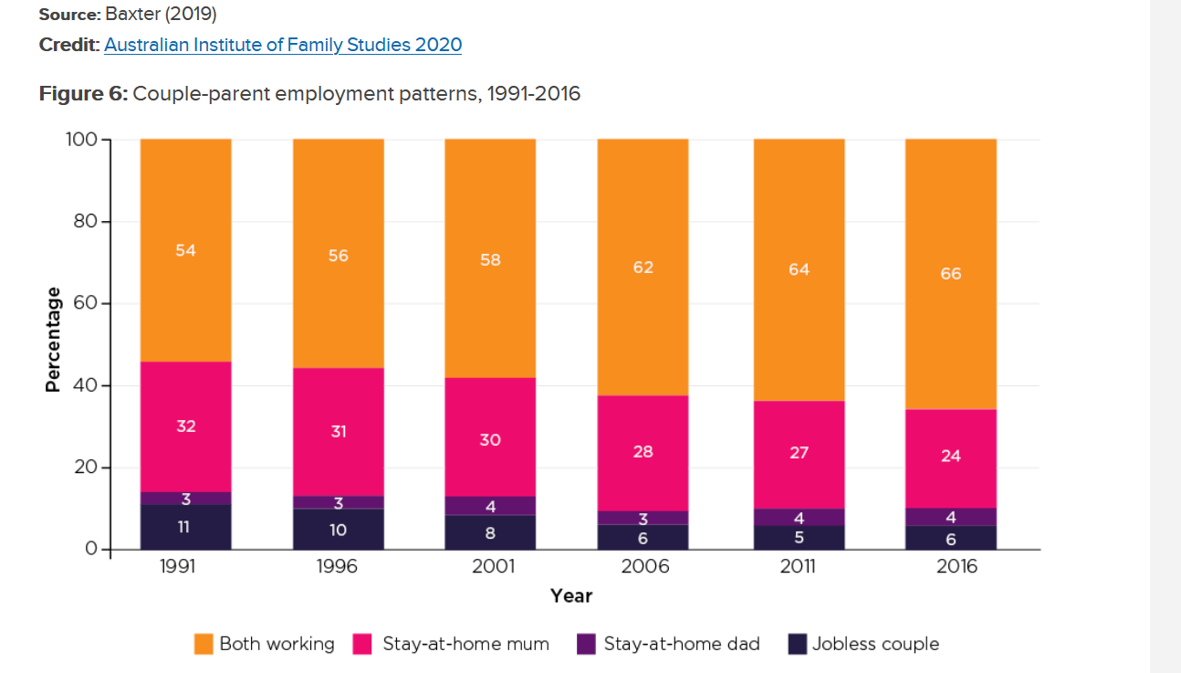
Families, care and work
Warren, Qu and Baxter ‘Families Now and Then: How we worked’ (AIFS, 2020) https://aifs.gov.au/publications/how-we-worked

Slide 6
When both parents work
Warren, Qu and Baxter, ‘Families Then and Now: How We Worked’ (AIFS report 2021): https://aifs.gov.au/publications/how-we-worked
The number of hours men work does not change after children, whereas for women it does with reduction in full time work
Fathers typically balance caring responsibilities around work hours caring for children at night and on weekends, whereas mothers either work part-time, or seek flexible work (working from home and/ or flexible hours)
38% of mothers report working part-time in 2017 to accommodate caring responsibilities
20% of mothers work from home, and 40% of mothers have flexible hours

Slide 7
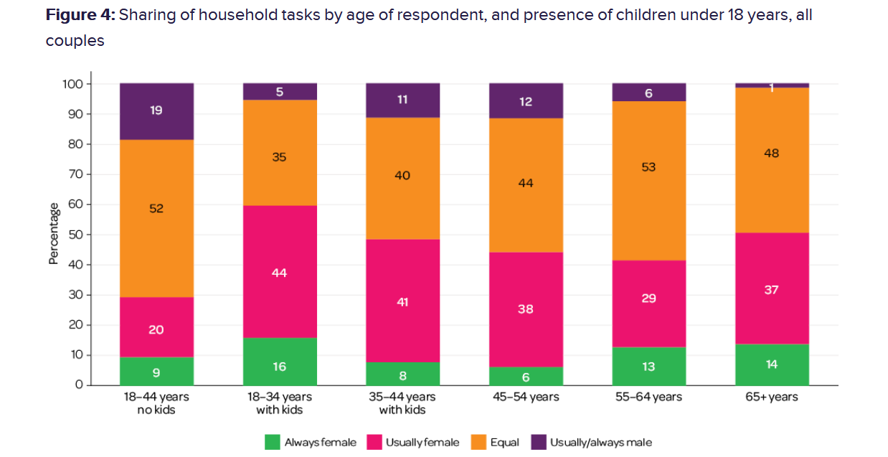
Household labour
Baxter, Sharing of Housework in Couple Families (AIFS, 2020) https://aifs.gov.au/publications/sharing-housework-couple-families-2020

Slide 8
Children in Australian Society
Culturally influential theories about children in Australian society
Concepts of children
Potential adults?
Vulnerable individuals?
Autonomous agents?
Stages of development
Newborn (birth – 2 months)
Infant (2 months – 1 year)
Toddler (1 year – 3 years)
Childhood. Early ( 4 - 8) Middle (9-11)
Adolescence ( 12 – 18)
Attachment theory (and related styles)
That children need at least one responsive and available primary caregiver (of either gender) in order to develop a sense of emotional security. They form the base through which children then explore the world and relationships with others.
https://positivepsychology.com/attachment-theory/#definition-attachment-theory

Slide 9
Children and International law
International Convention on the Rights of the Child (UNCRoC/ CRC)
Adopted and open for signature on 20 November 1989, entry into force 2 September 1990
Australia signed and ratified in December 1990.
One of the most signed international conventions with 192 states (USA has not signed).

Slide 10
General principles of UNCROC
Enhancing child autonomy – promote wishes and inclusion in decisions
Full realisation of other rights (education, health, family, identity, freedom from discrimination)
Protection from harm – including acknowledging that removing children from family units makes children vulnerable (adoption, child welfare etc)
Enhancing capacities and development
Standard for decisions, policies and actions taken for children should be in their ‘Best Interests’

Slide 11
Article 3
Best interests of the child, for each child
(1) In all actions concerning children, whether undertaken by public or private social welfare institutions, courts of law, administrative authorities or legislative bodies, the best interests of the child shall be a primary consideration.
(2) States Parties undertake to ensure the child such protection and care as is necessary for his or her well-being, taking into account the rights and duties of his or her parents, legal guardians, or other individuals legally responsible for him or her, and, to this end, shall take all appropriate legislative and administrative measures.

Slide 12
Article 9
Right to live in a family except by lawful removal necessary to protect the child
(1) States Parties shall ensure that a child shall not be separated from his or her parents against their will, except when competent authorities subject to judicial review determine, in accordance with applicable law and procedures, that such separation is necessary for the best interests of the child. Such determination may be necessary in a particular case such as one involving abuse or neglect of the child by the parents, or one where the parents are living separately and a decision must be made as to the child's place of residence.

Slide 13
Article 12
Right to express views
(1) States Parties shall assure to the child who is capable of forming his or her own views the right to express those views freely in all matters affecting the child, the views of the child being given due weight in accordance with the age and maturity of the child.
Right to have input into decisions affecting them
(2) For this purpose, the child shall in particular be provided the opportunity to be heard in any judicial and administrative proceedings affecting the child, either directly, or through a representative or an appropriate body, in a manner consistent with the procedural rules of national law.

Slide 14
Article 30
Right to enjoy culture in community
In those States in which ethnic, religious or linguistic minorities or persons of indigenous origin exist, a child belonging to such a minority or who is indigenous shall not be denied the right, in community with other members of his or her group, to enjoy his or her own culture, to profess and practise his or her own religion, or to use his or her own language

Slide 15
Children and Australian family law
Incorporation of UNCROC in FLA
Family Law Amendment (Violence and Other Measures) Act 2011 (Cth)
Explanatory memorandum p 8 explains expansion of ‘objects and principles’ s60B to
‘to provide that a further object of Part VII of the Act is to give effect to the United Nations Convention on the Rights of the Child (the Convention). The purpose of this object is to confirm, in cases of ambiguity, the obligation on decision makers to interpret Part VII of the Act, to the extent its language permits, consistently with Australia’s obligations under the Convention. The Convention may be considered as an interpretive aid to Part VII of the Act. To the extent that the Act departs from the Convention, the Act would prevail. This provision is not equivalent to incorporating the Convention into domestic law.’

Slide 16
Children and the FLA
Protection from harm 60B(1)(b), 60CC(2)(b),
Maintaining family structure
Right to know ‘both parents’ s60B(1)(a), s60CC(2)(a)
Support parental duties and responsibilities s60B(1)(d),
Best Interests standard
60B(1)(a) (modifies right to know and spend time with parents)
60 CA paramount consideration in decision making
60CC generally
Children’s views: s60CC(3)(a)
Children’s right to culture: s60B(2)(e), 60B(3), 60CC(3)(f), 60CC(3)(h), 60CC(6)
Children expressing their views 60CD(1)
Reports for eg family consultant reports 60CD(2)(a)
Independent children’s lawyers (ICLs) 60CD(2)(b)
Other means for eg Judicial Interviews 60CD(2)(c)

